Slide 1

Sales Training
Fabrikam Sales Meeting 2006

Slide 2
Basic Sales Process
Prospect
Qualify
Propose
Pilot
Close

Slide 3
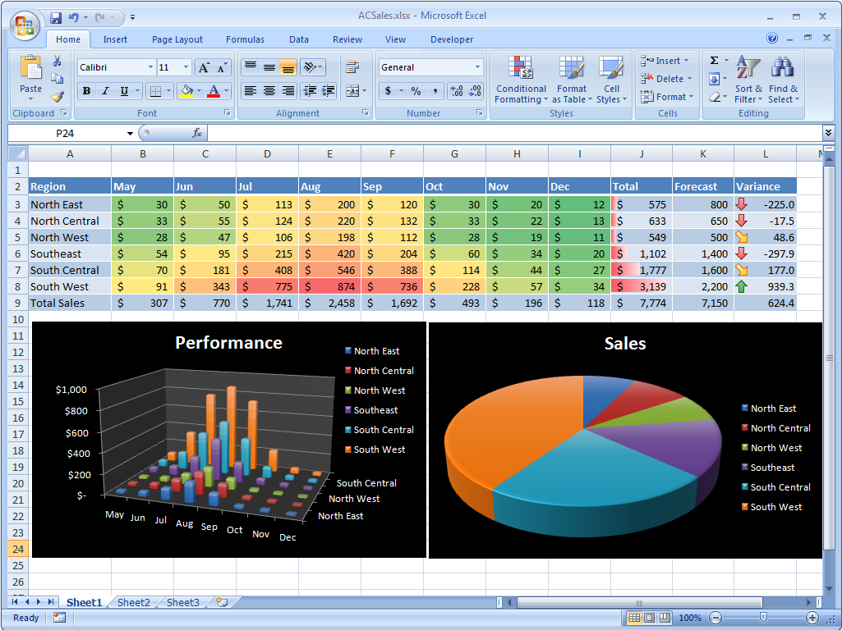
Reporting
New Reporting Tool
Full sales cycle reporting
Easy to use

Slide 4
Qualifying
This is what inside sales is for
Build relationships with your area rep
Take good care of them
They are not there to fulfill collateral orders
Keep them informed so they can do their best work
Keep focused on discovering customer needs
Leverage your understanding of industry trends
DO YOUR HOMEWORK

Slide 5

Proposal
The other most important step
Don't wait until the last minute
Your crisis is your crisis not the proposal team's
Double check EVERYTHING
Legal needs 5 working days to review
See online resources for training on the proposal generator

Slide 6

Pilot
Where the rubber meets the road
Stay involved during this process
Identify challenges before they turn into show stoppers
Your technical resources need to understand the big picture
It is a team win – or no win at all!

Slide 7
Close
ONLY YOU CAN CLOSE THE DEAL
You have to ask for the order
It’s that simple – go out there and DO IT!

